Slide 1

NO PHISHING ZONE
ADAM MILLS
DYLAN REDDEN
CHRIS SCHMITT
DENNIS UGBEBOR

Slide 2

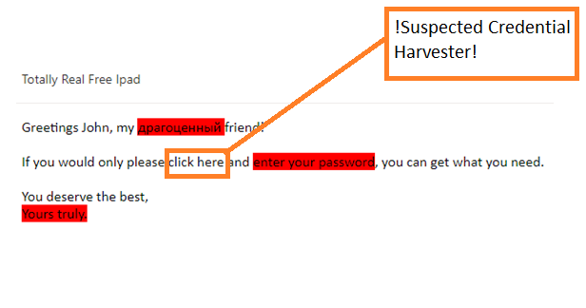
WHAT WILL IT BE?
WHY DO WE WANT TO DO THIS?
Web Browser Extension
Continuously scans pages for:
“Red Flag” language
Malicious links
Spoofed sender address
Highlights what to avoid
Alert pop-ups
You and I know what to avoid, but does the average person?
Limitations of safe-browsing training
Give the end-user a tool which may alert them to malicious activity they may not notice

Slide 3
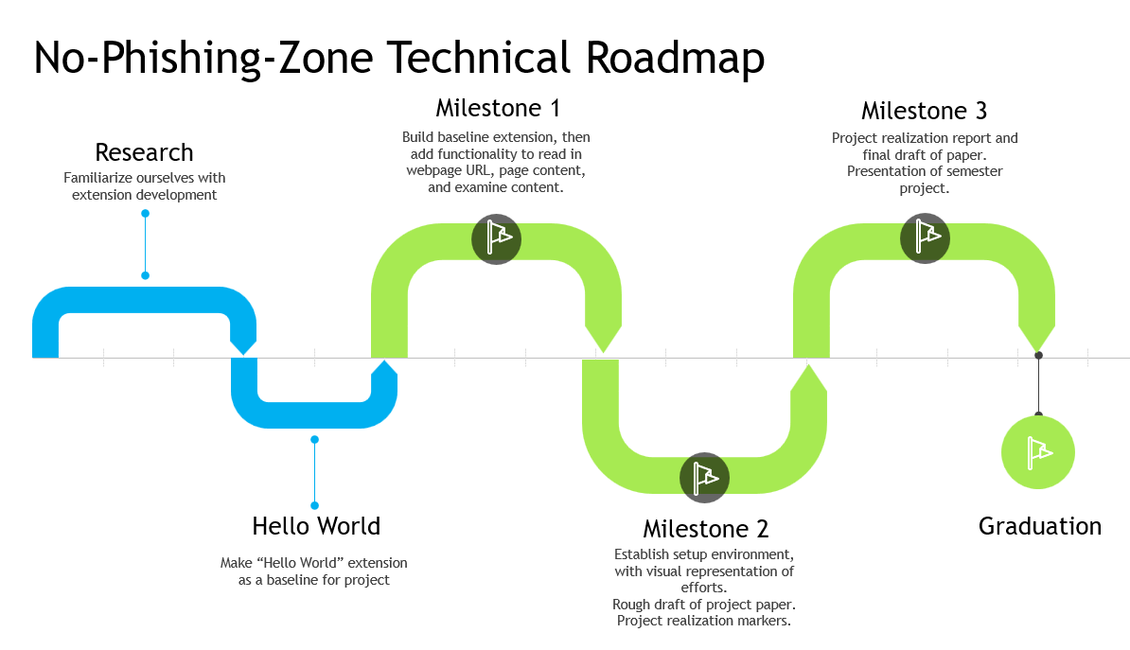
Estimated Timeline

Slide 4
WHAT RISKS MIGHT WE FACE?
Limited project timeline
Web Development Woes
Can the team come together to reach the finish line?
Product ineffectiveness
Changes to the Chrome development environment

Slide 5
WHAT WILL WE NEED?
Access to research databases
Test Dataset to test the extensions functionality.
Programming IDE
Github access and fundamentals
Chrome developer mode
Polish our web development skills

Slide 6

QUESTIONS? FEEDBACK?

